Slide 1
Intro to Deep Learning Fracture X Ray Classification Final Project
Claire Cao

Slide 2
Machine Learning Problem
Goal: create a model to classify x ray images as containing a fracture or not
Medical imaging, such as x rays, is important in medicine to make diagnoses.
Identify any abnormalities vs normal
An example is being able to analyze any bone to determine if there are any fractures present in the x ray images vs a normal image.

Slide 3
Dataset
Created by bmadushanirodrigo
Has fractured and non-fractured X-ray images from different anatomical body regions
Lower limbs, upper limbs, hips, knees, etc.
Categorized into train, test, and validation folders
Each folder contains fractured and non-fractured x ray images.
10,580 x ray images in total
9246 images in training dataset
828 images in validation dataset
506 images in test dataset

Slide 4
Machine Learning Approach
CNN was used.
Classify images as 'fractured' or 'not fractured' based on the training and learning that it does to analyze images and determine if there is a fracture present in the image
Good choice when analyzing and classifying images
Able to automatically extract features and utilize spatial structure
Still has good accuracy and efficiency

Slide 5
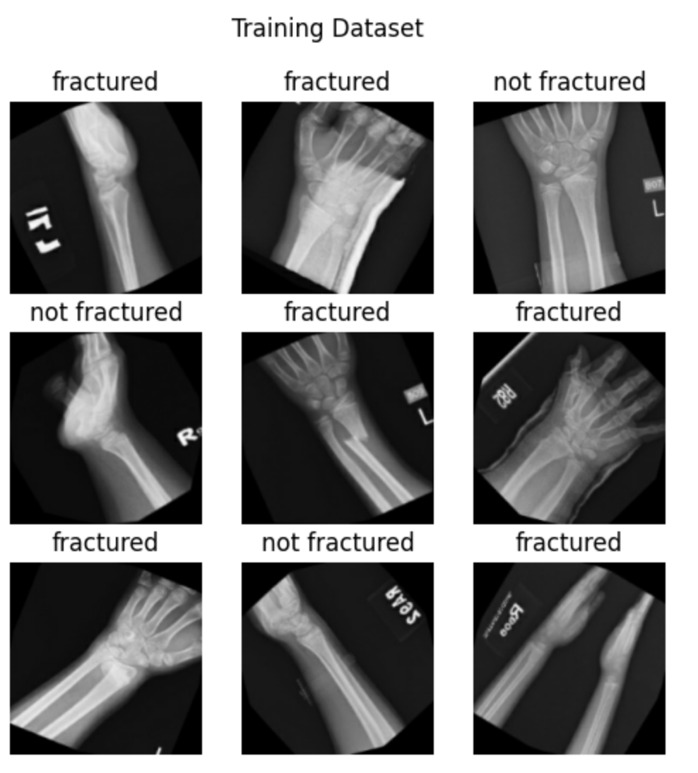
The image on the left shows a few example x ray images found in the training dataset along with the label of if there is a fracture present or not.

Slide 6
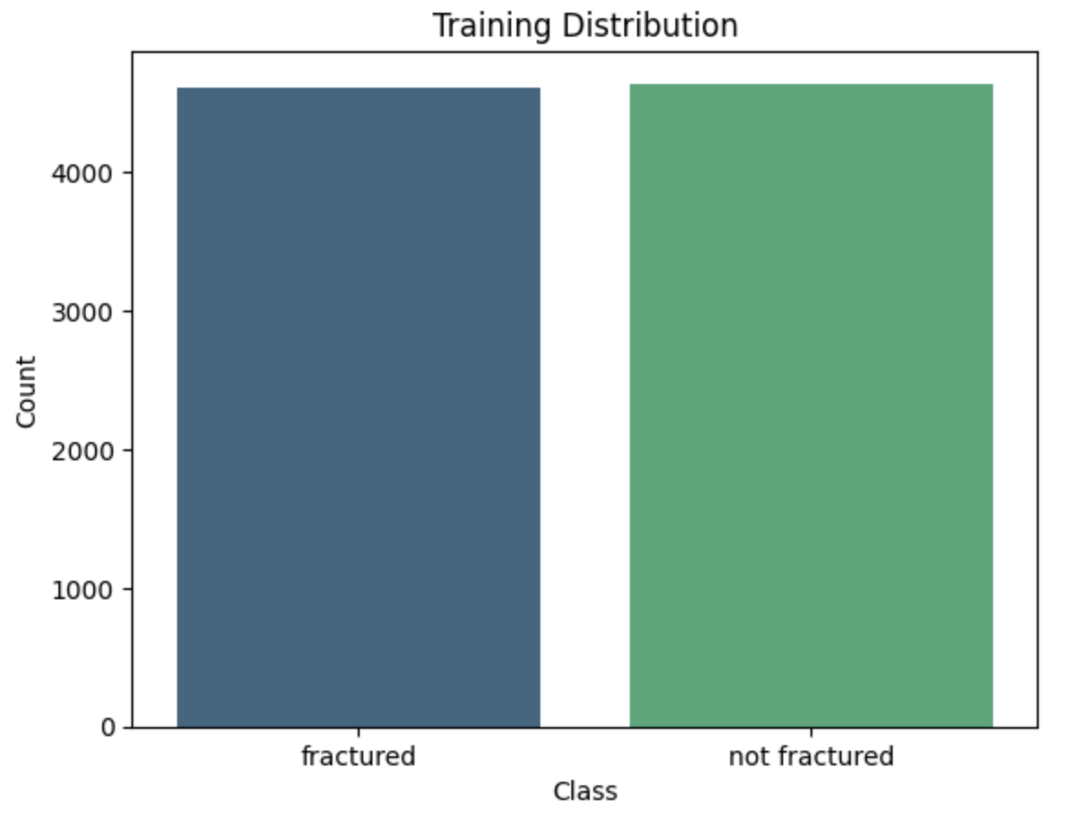
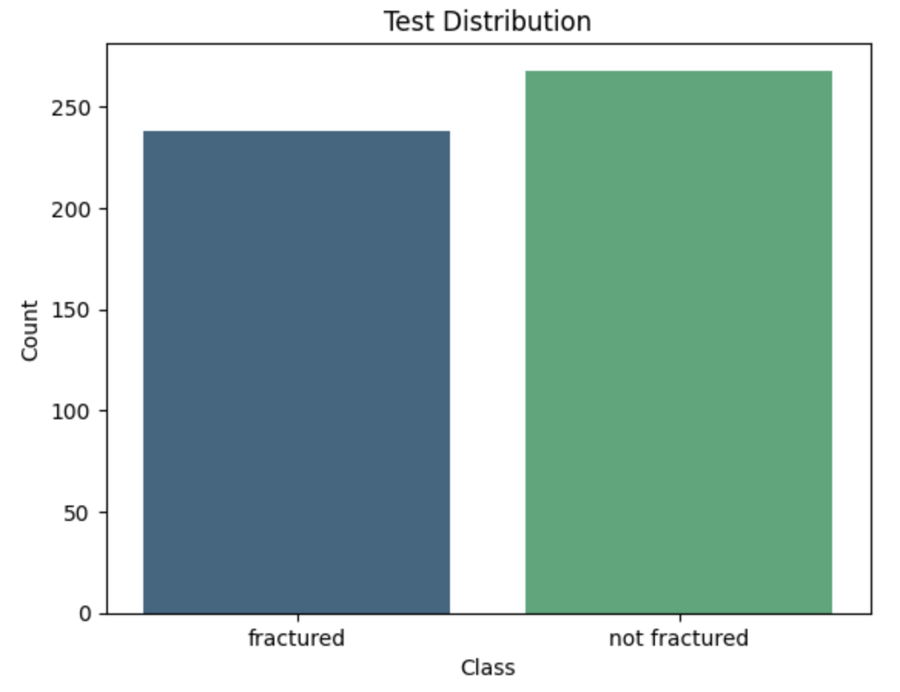
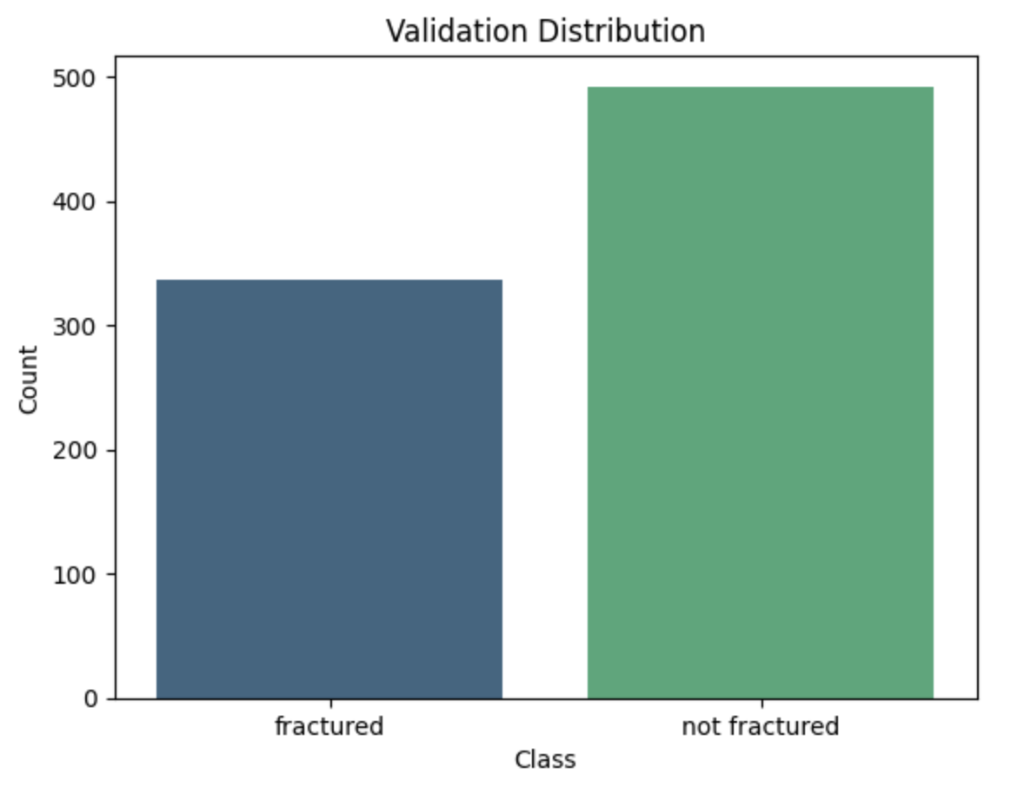
These bar charts show the number of x ray images that are classified as fractured vs not fractured in the training, test, and validation datasets. In the training data, approximately half of the images are fractured and the other half is not. The test data has just below 250 fractured x ray images and just above 250 non-fractured x ray images. Lastly, the validation dataset has close to 500 non-fractured images and close to 350 fractured images.

Slide 7
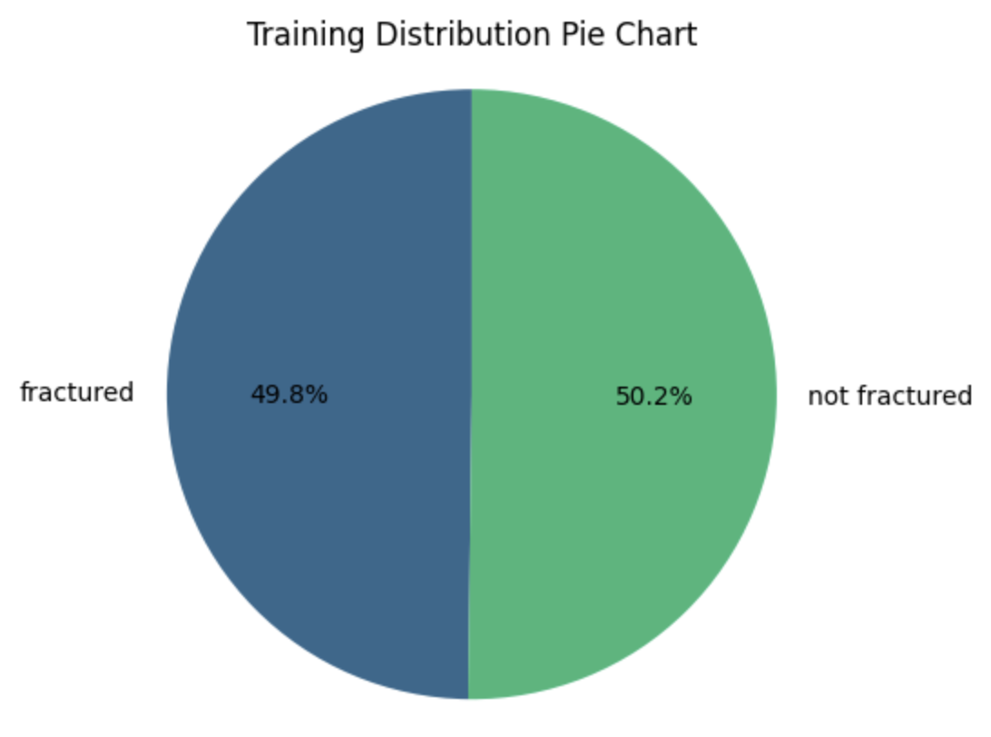
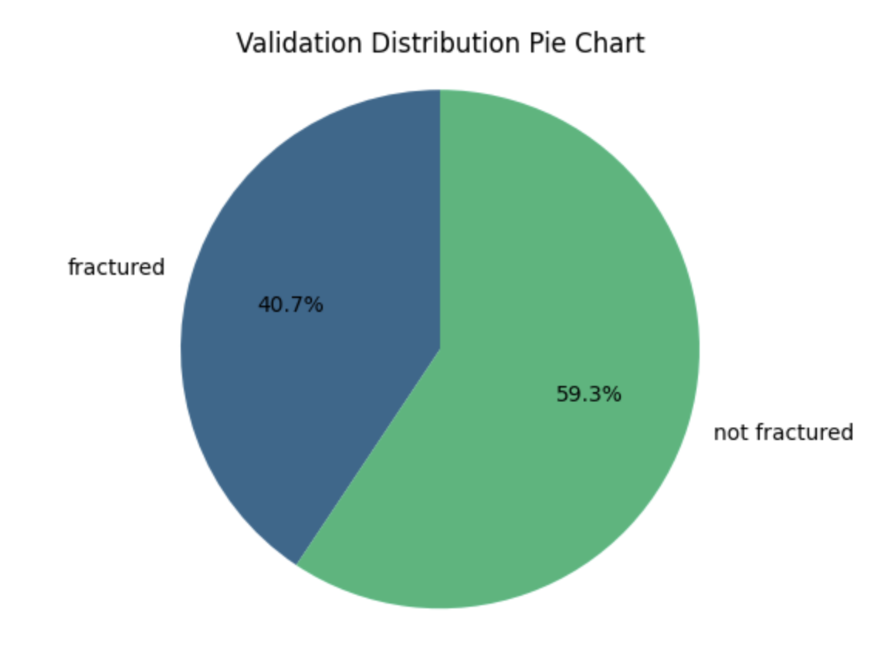
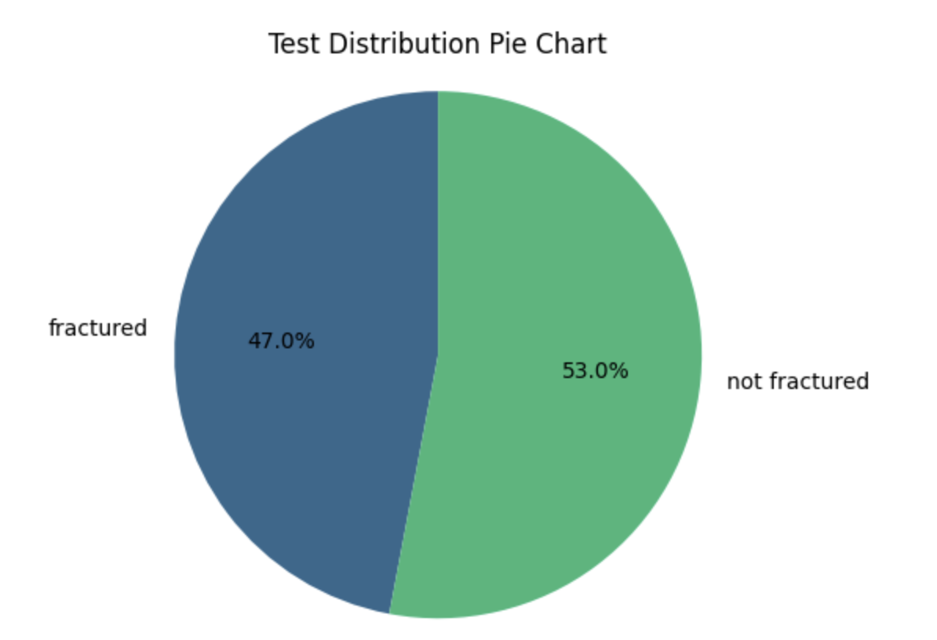
These pie charts show the percentage of how many x rays are classified as fractured vs not fractured in the three datasets (training, test, validation). The training dataset has 49.8% fractures and 50.2% not fractured. The validation data has 59.3% of the images without fractures and 40.7% with fractures. The test data has 53% of the images classified as not fractured while the other 47% contain fractures in the x ray images.

Slide 8
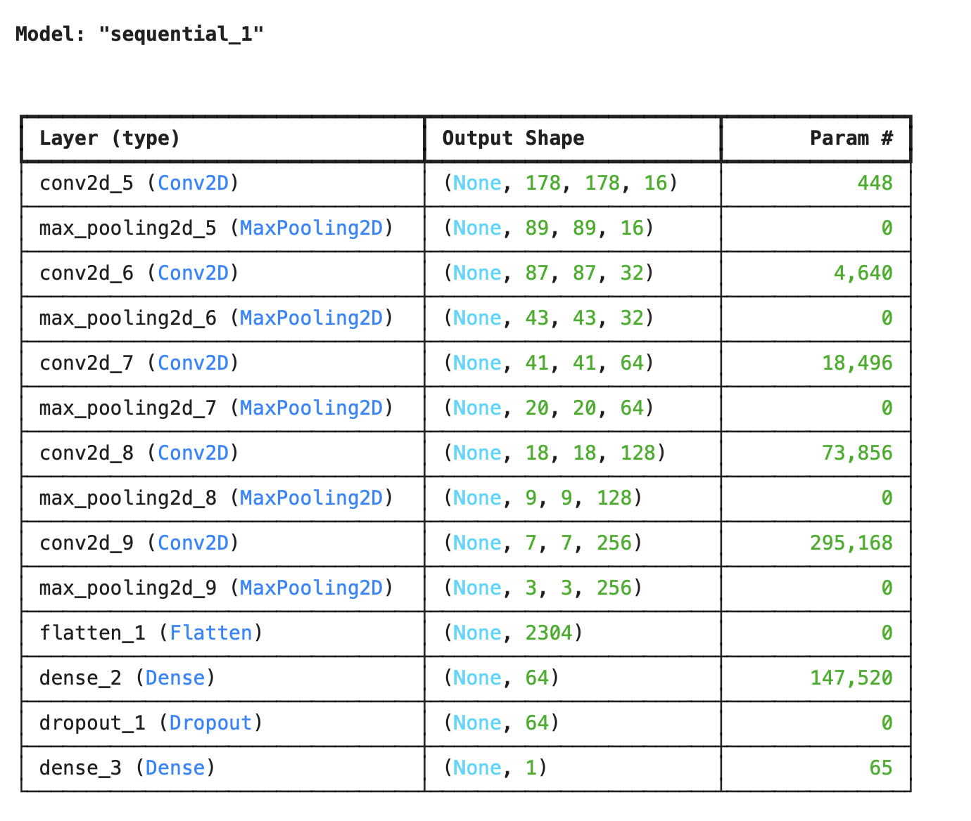
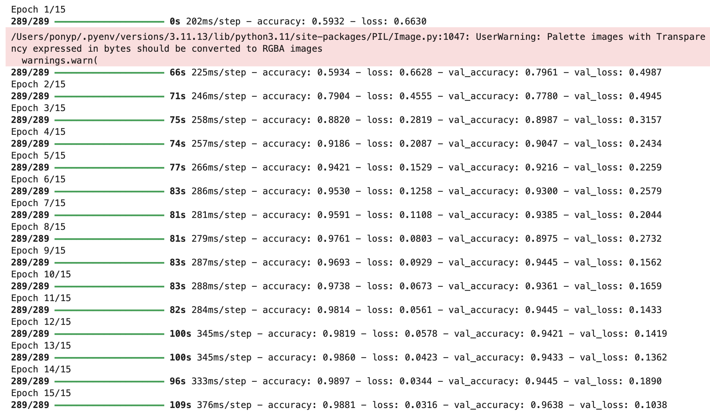
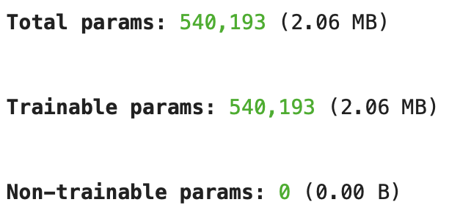
This shows the results of the first model using the training and validation datasets. The best accuracy was 0.9897 and the lowest loss value was 0.0316. The best validation accuracy was 0.9638 and the lowest validation loss was 0.1038.

Slide 9
The is the accuracy and loss of the first model using the test dataset. The accuracy ended up being 0.97 and the loss was 0.08.

Slide 10
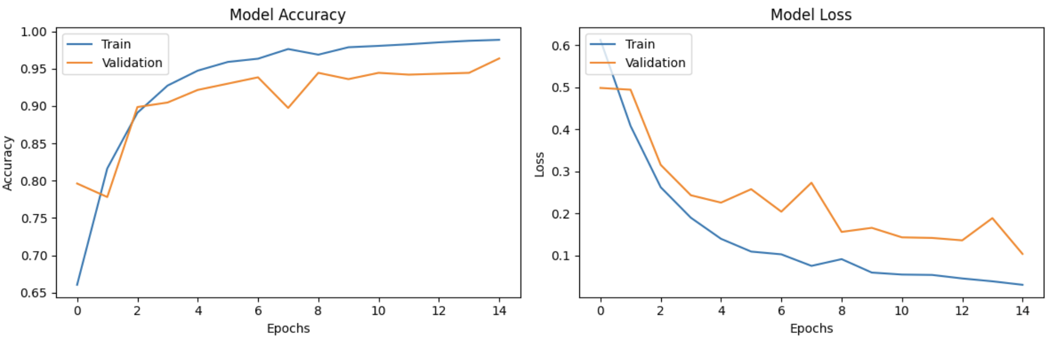
The graphs above show how the accuracy and loss changed after each epoch for both the training and validation datasets. The accuracy continued to improve after each epoch and started to plateau about halfway through. The loss graph shows that the loss decreases as the model learns.

Slide 11
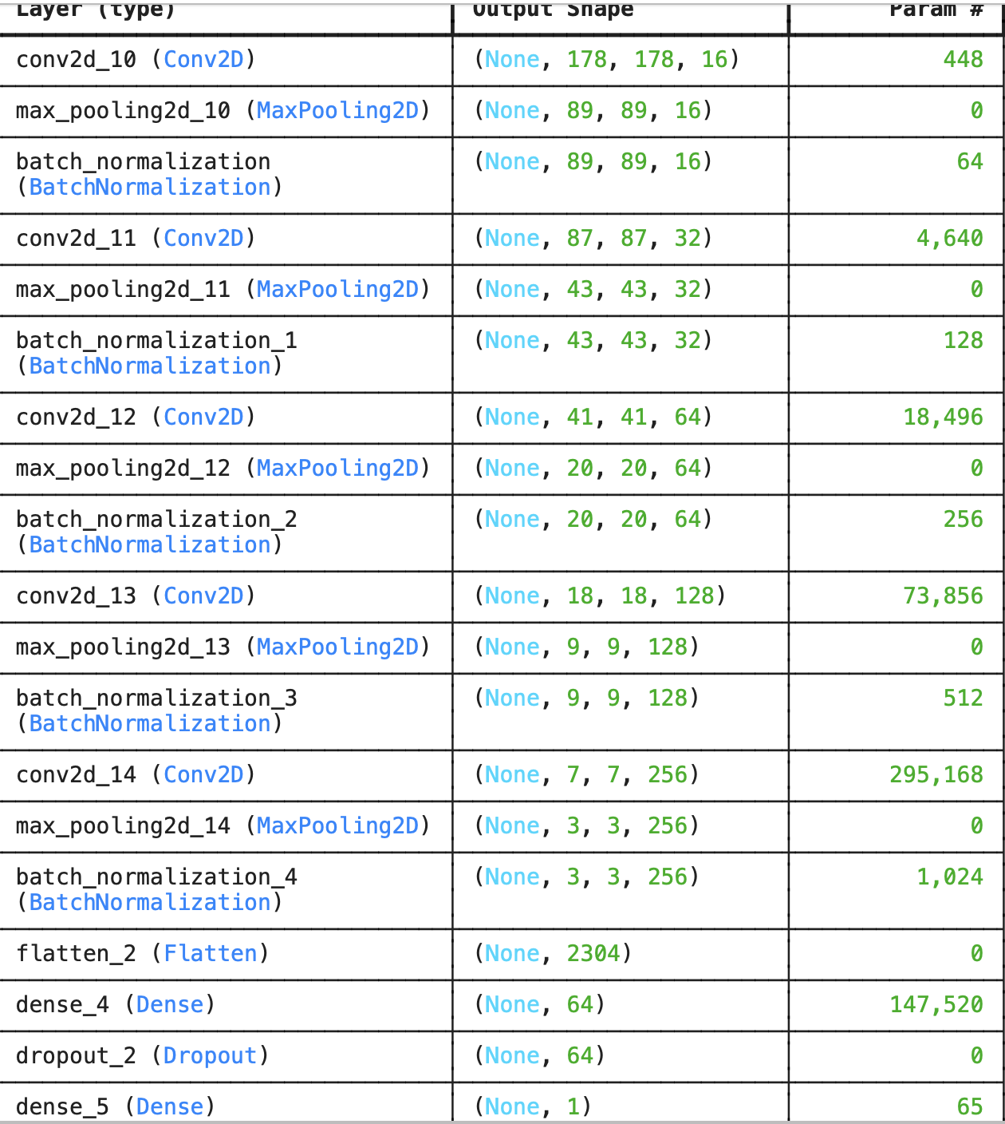
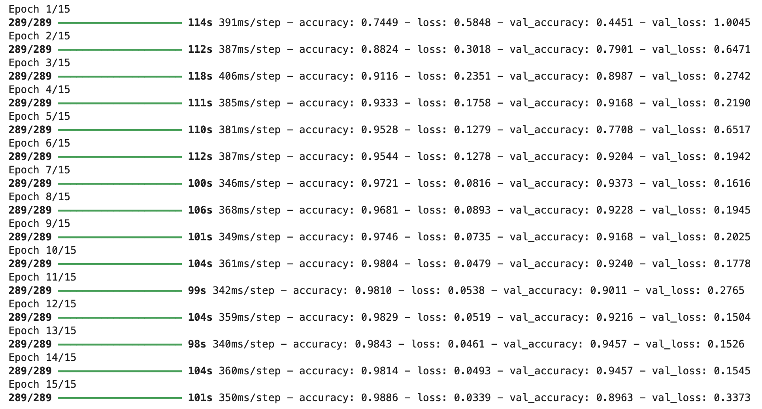
This shows the results for the second model using training and validation data. The best accuracy was 0.9886 and the lowest loss was 0.0339. The best validation accuracy was 0.9457 and the lowest validation loss was 0.1504.

Slide 12
This shows the accuracy and loss of the test dataset when used in the second model. The loss was 0.4 and accuracy was 0.89.

Slide 13
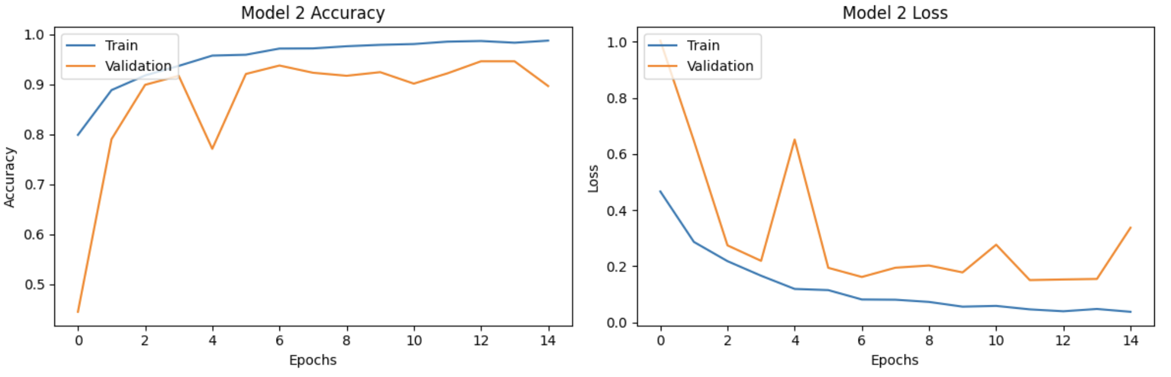
These two graphs plot the accuracy and loss of the model as each epoch is completed. The accuracy had some improvement and started to plateau around epoch 4 or 5. The loss decreased as the epoch number increased.

Slide 14
Conclusion
Model 1 seems to work better than model 2 because it had a better accuracy, lower loss for all three datasets (training, validation, and test).
Altering hyperparameters and layers can change how well a model performs and its accuracy.

Slide 15
References
Kaggle dataset link: https://www.kaggle.com/datasets/bmadushanirodrigo/fracture-multi-region-x-ray-data/data
GitHub repository link: https://github.com/claire01234/Intro-to-Deep-Learning-Final-Project.git

